Slide 1

Web Sites with XHTML and CSS
Case Study
Dimiter Kunchev
National Academy for Software Development
academy.devbg.org

Slide 2

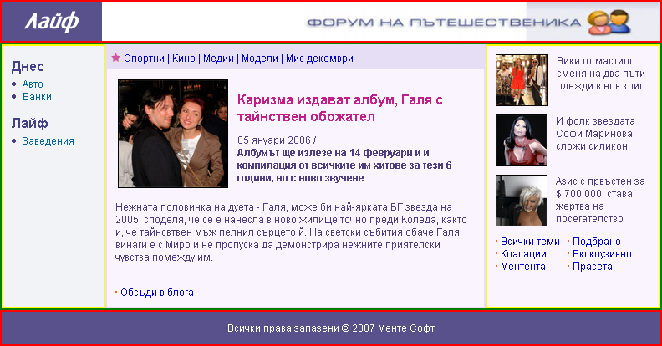
Step 1 – Determine the Pieces
First step is to determine the parts of the design

Slide 3
Step 1 – Determine the Pieces
This is the logo –
should be image tag
the site header - div
This can be background image

Slide 4
Step 1 – Determine the Pieces
3 columns design
Best way is – table, one row, three cells
Menu cell
Body cell
Right cell

Slide 5
Step 1 – Determine the Pieces
Footer – div, center the text with CSS

Slide 6
Step 1 – Determine the Pieces
DIV with links (A tags)
Article headings
(H1 and H2 tags)
Unordered lists, strong tags, links
two separate lists in table or two floating divs

Slide 7
Tables or not Tables?
Using tables for columned design is semantically incorrect
  All cells have same height
  Tables are considered SEO unfriendly
The other option is <div> tags
  To place them in columns they must be floating
  When they are you can fix their width, but height is determined by content, or fixed
  When height is determined by content, background may not be applied properly
  Footer must also be floating with clear:left

Slide 8
GIF, JPEG or PNG?
GIF, JPEG and PNG are the three most common image formats in the Web
  JPEG is used for large images
  GIF and PNG are used where transparency is needed
    Most often for bullets, small images, etc
    PNG transparency is not supported by old browsers
    PNG files are larger than GIF
    GIF supports less colors than PNG
    GIF supports animation

Slide 9
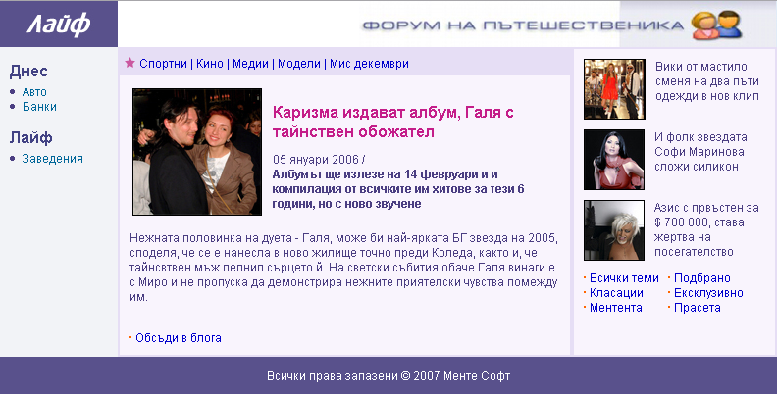
Step 2 – Which Parts are Image and Which HTML?
Use HTML when possible to avoid images
  Images are slower to download and render
Browsers do not support such font and effects so we have to place this text using image
This bullets can be either CSS background image or default list bullet
All elements backgrounds and borders are solid so we can use css colors instead of images

Slide 10
Step 3 – The Small Details
Look for the small details and decide if they should be in CSS, HTML or image
Example: this images have border that should be defined in the CSS, not part of the image

Slide 11
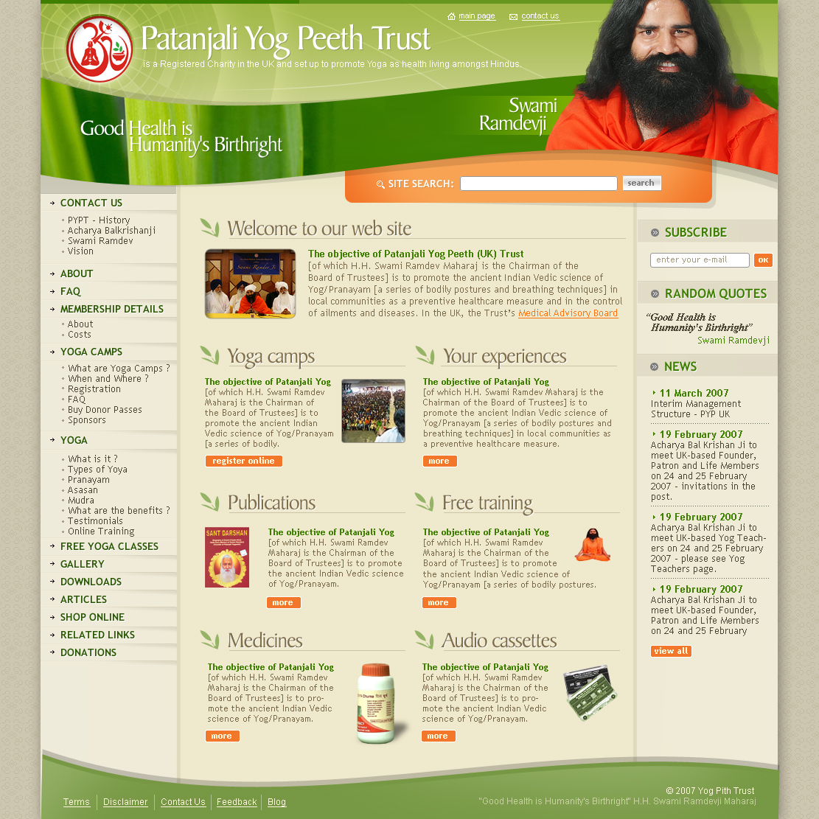
Case Study
Example
site
design
http://pypt.org/

Slide 12

Case Study: Text or Image
Three ways to create the top part:
  Use text over background image, absolute positioned divs
  Use table, slice the image to fit the needed rows and columns
  Leave the text in the image

Slide 13

Case Study:
Two Backgrounds
To achieve the underline and the leaf image we can use only CSS. We need two tags:
  Outer tag has the leaf as background image, padding-left so the inner doesn’t cover it
  Inner tag has the underline as background image, repeat-x, positioned in the bottom
  Note: the underline background image is 1px wide to save bandwidth!

Slide 14

Case Study:
Rounded Corners
Rounded border corners are supported by CSS3
  Not yet supported by most browsers
    But soon will be
  We can create them with multiple images in table
    Too much code

Slide 15
Case Study:
Centering the Site
There are several ways to center the content of the site
  Placing it in <center> tag - deprecated
  Using CSS text-align:center
    Will affect all child nodes too
  Using CSS left:50% and negative left margin
    The width of the content is fixed
    We can set margin as –width/2
left:50%;width:800px;margin-left:-400px

Slide 16
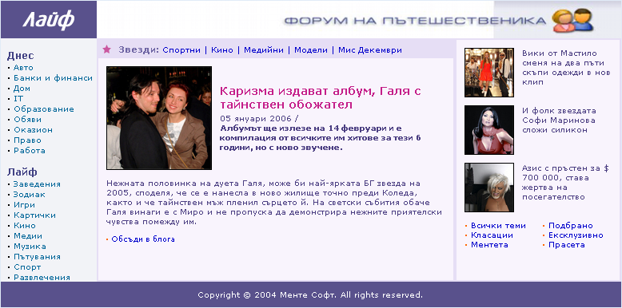
Problems
Create this site's XHTML and CSS

